Slide 1


What Drives Winning in the NBA?
Data-Driven Insights from Player and Team Performance
Bek, KJ, Sunee, Vignesh

Slide 2

Dataset Overview & Business Context
Large NBA dataset containing player-level and team-level game statistics
Dataset Details
Data: 80 Years - 1.6M Records
Attributes: 20+ Performance Fields
Grain Levels: Player, Team, Game
Business Relevance
Mirrors how NBA front offices, coaches, and analysts evaluate performance and enables data-driven decisions in:
Player Development
Roster Construction
Game Strategy
Performance Evaluation

Slide 3
Data Wrangling & Preparation
Initial Data Processing
Raw NBA data ingested from source files into a relational database
Data inspected for completeness, consistency, and structure
Cleaning & Filtering
Removed duplicate and incomplete records
Standardized team names, player identifiers, and game IDs
Filtered data to include valid NBA games and players only
Transformations & Aggregation
Converted raw game logs into player-level fact records
Aggregated player statistics to derive team-level metrics
Verified record counts before and after transformations

Slide 4
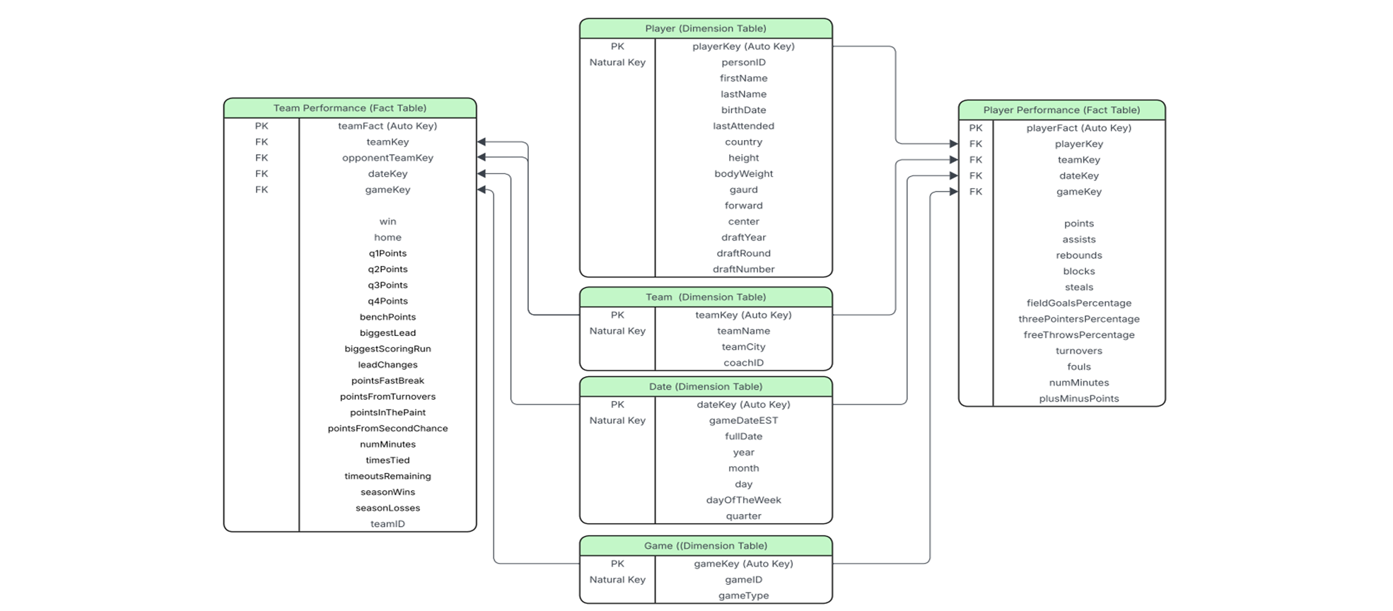
NBA Data - Star Schema

Slide 5
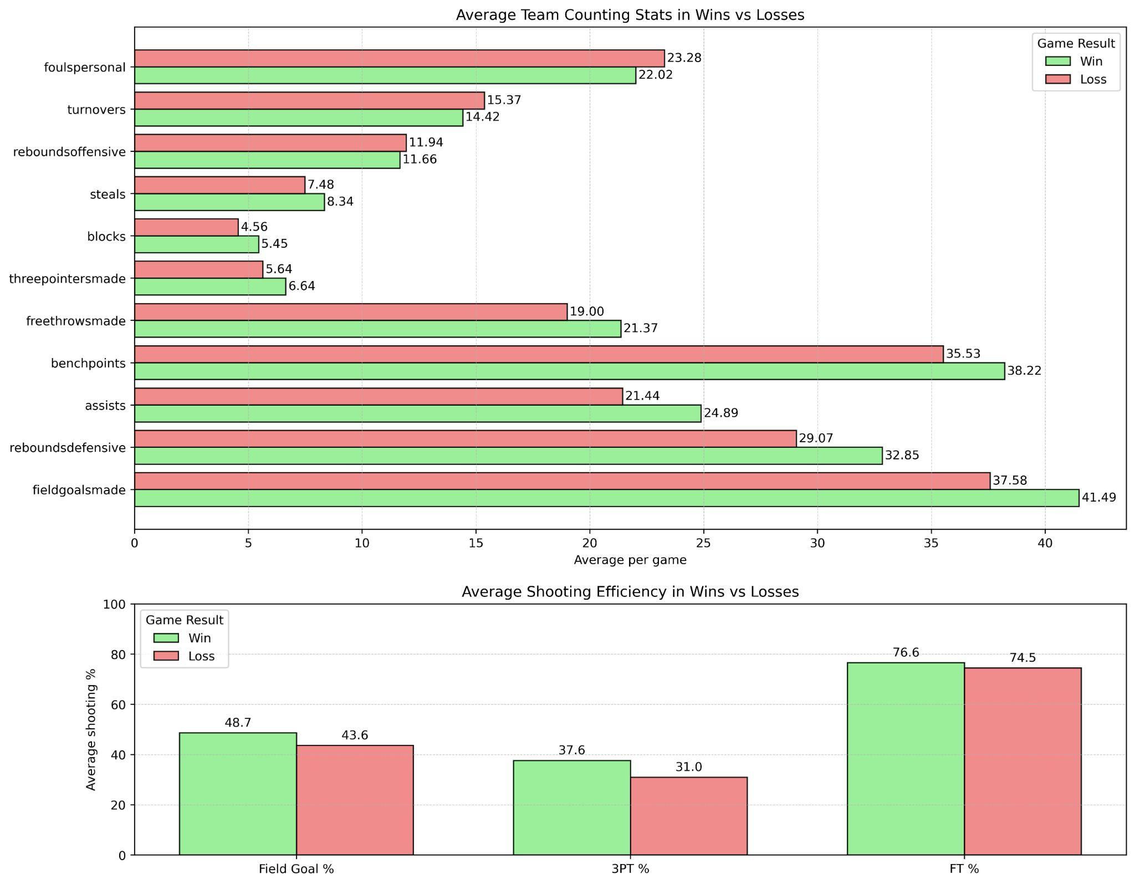
What Separates Winning Teams from Losing Teams?
This visual highlights the most consistent “winning” stats across all games:
More Field Goals & 3PTs
More Assists
More Defensive Rebounds
More Bench Depth
Less Fouls and Turnovers
Business takeaway
Sponsors perspective:
Performance informing visibility
Informs choice of partnership

Slide 6
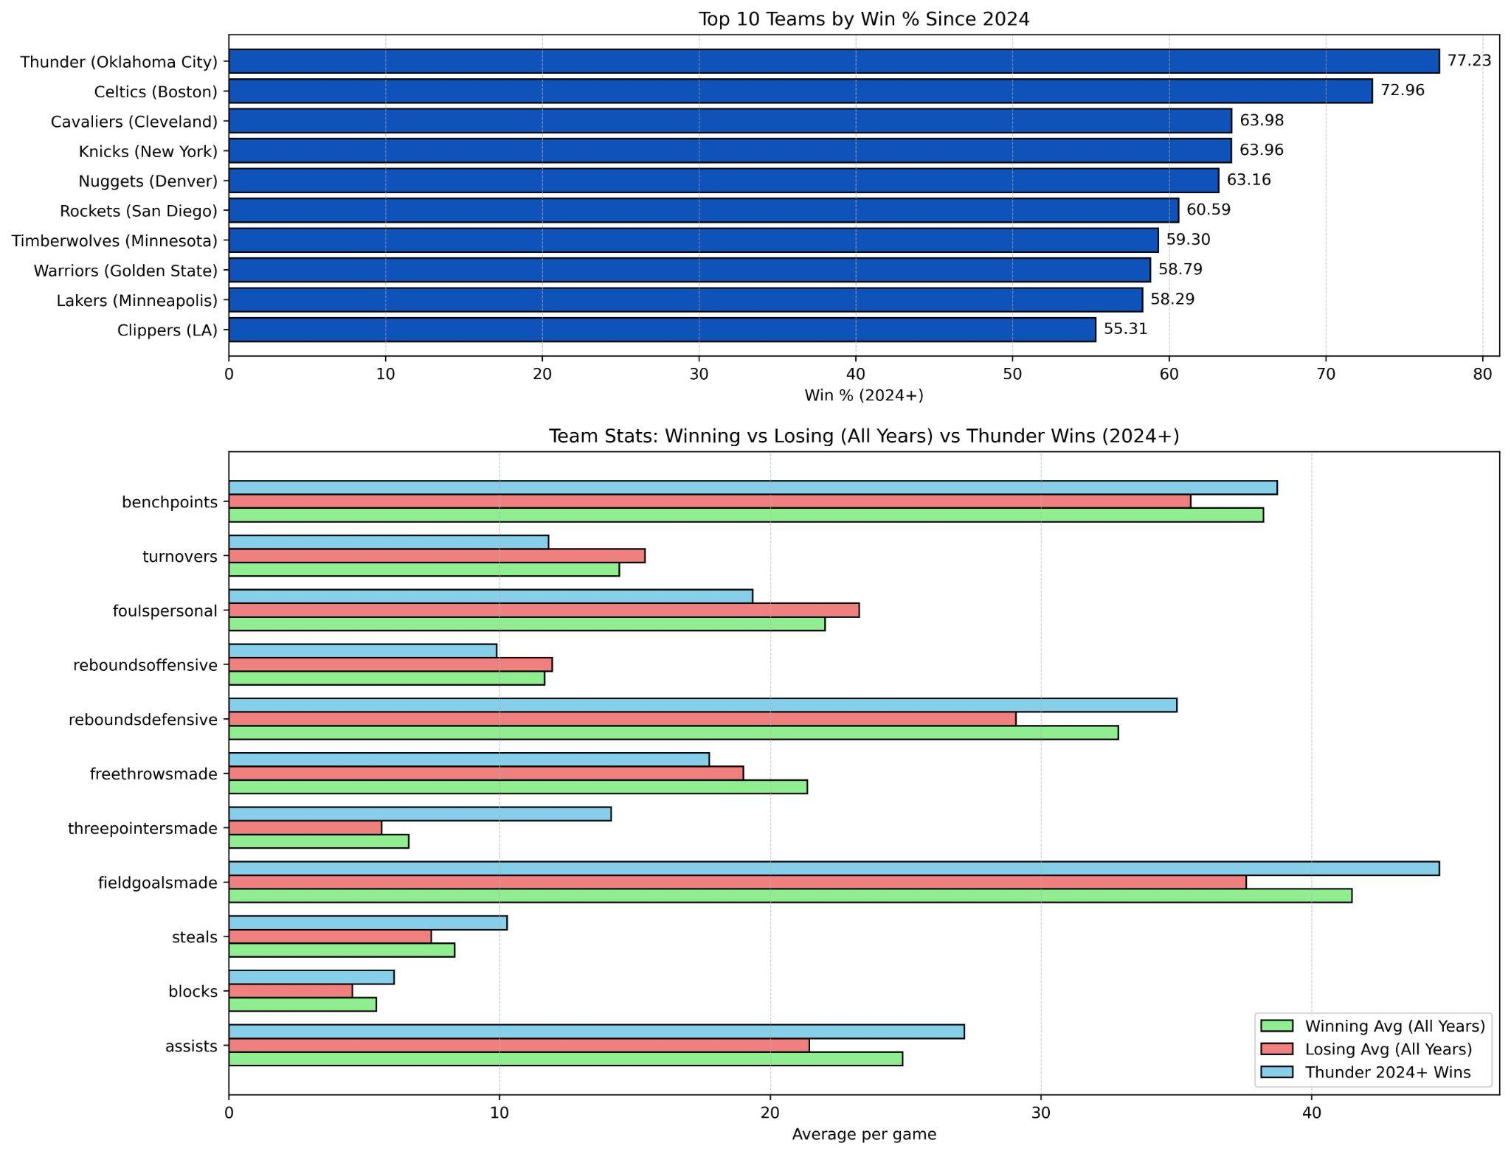
Case Study: Oklahoma City Thunder - A Winning Profile
Why Team Thunder?
Highest win percentage (77%) among all teams since 2024 and serves as a benchmark for a high-performing team
Key Insights
Thunder confirms winning team observations.
Higher than average in 3PTs, assists, field goals made, and defensive rebounds
Lower than average in turnovers and fouls
Business takeaway
Team Manager perspective:
Wins drives ticket revenues
Higher media rights revenues

Slide 7
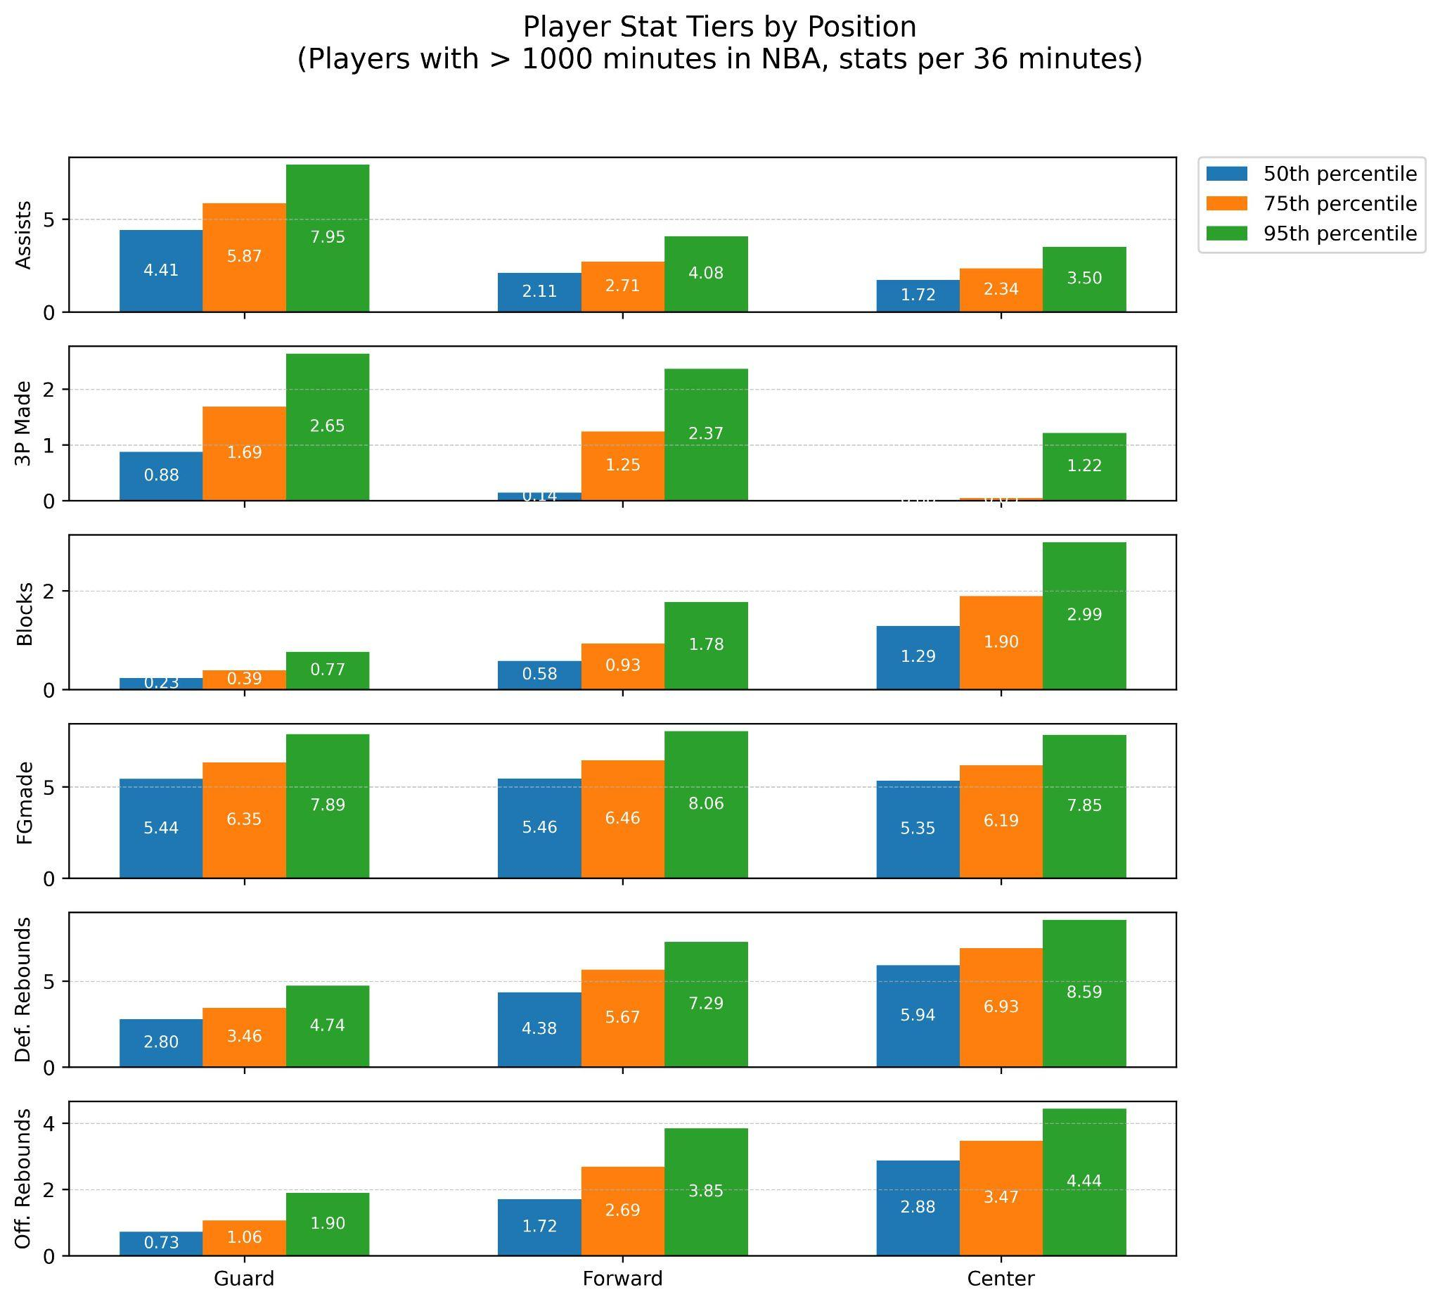
What are key player performance stats for each position?
This visual sets clear benchmarks for the stats shown, by position. It includes only players with minimum 1000 minutes of total game time
Guards - Assists and 3P Made
Forwards - Rebounds and Field Goals
Centers - Blocks and Rebounds
Business takeaway
Owning top talents impacts marketing revenue
Benchmarking informs player endorsement decisions

Slide 8
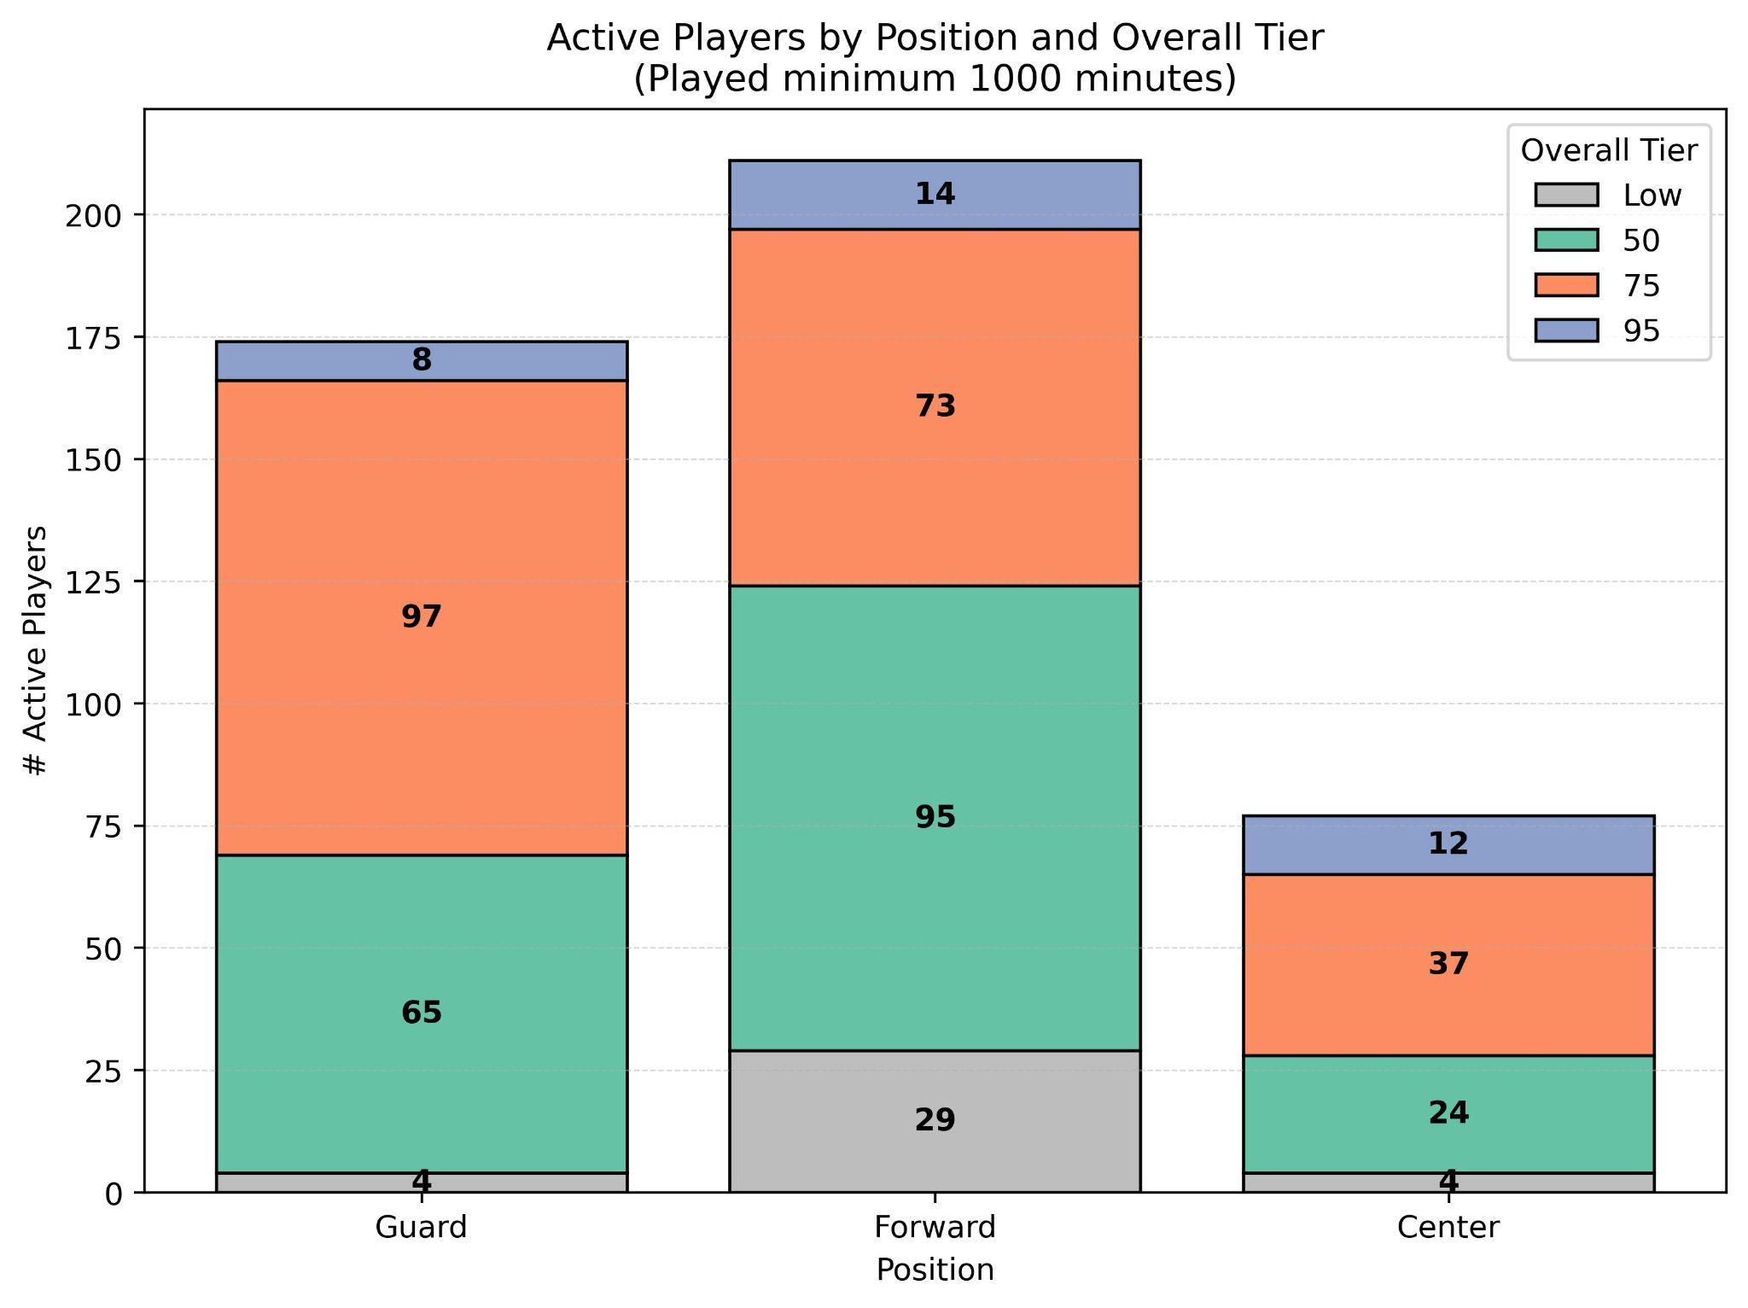
How is the overall performance of currently active players?
Overall tiers were made based on the benchmarks and position based percentile stats identified earlier
Few in Tier 95 : Guard 8; Forward 14; Center 12
Forwards show the broadest depth in the middle tiers: Tier 50 = 95; Tier 75 = 73
Clear groups for decision-making: This separate players into performance tiers within each position
Business takeaway
Player performance distribution by position helps plan drafts and player selection
Informs budgeting strategy by position

Slide 9
Summary
Our 80-year NBA dataset allowed us to create a winning team and top player benchmarks that can be used for strategic decisions in Sports Management.
Team Manager Standpoint:
Knowing performance drives revenues in ticket and media rights
Higher performance brings in more people in arena and watching live.
It's a crucial metric to pinpoint better cost planning for training and staff member choice.
It helps manage marketing plans and choice with their top talents.
Sponsorship Point of View:
Performances helps in identifying the best team or player for visibility,
It impacts marketing planning and budgeting.
Player performance benchmarks informs endorsements and campaigns decisions.

